Slide 1


Supporting Undocumented Students on Our Campus
3-part Training:
1. Foundational Knowledge Training (you are here!)
2. Taking the Next Steps
3. Becoming an Ally Training
Training 1
(60 minutes)
Notes:
2 minutes kim
Goal of this slide: introduce training, facilitators, and participants
Talking Points: Introduce facilitators, have participants share their name and where they work on campus.
“This workshop will situate the experiences of undocumented students in college, provide foundational knowledge and information for advising and mentoring, as well as encourage the completion of the remainder of the series.”
Trainings two and three have a lot more room for dialog and department focused work.

Slide 2
UndocuAlly Trainings at Cuesta College
Originally trained by Dr. Elena Macias, former Special Assistant to the President at CSU Long Beach in 2015
  AB540 Ally Training Project Lead
    Ab540.com | elena.macias@ab540.com
Adapted training materials to fit our institutions and audiences
Notes:
1 minute Estella
Goals: credit Dr. Elena Macias for her role in this series
Talking points: Members of the LLN were first trained by Dr. Elena Macias in 2015. We then adapted the training materials into our 5-hour training series (or something like this). We have offered this training to over 800 educators and allies on the central coast. We also recognize that for some of you, this information may be review and you may have certain expertise that we do not. We appreciate any feedback that you may have, as well as any expertise or experiences you can bring to the table.

Slide 3
3-Part Training Series: Creating Change at Three Levels
In individual knowledge & interactions
In our offices, programs, departments, and/or organizations
University-wide | Advocating for Institutional-level Support
Notes:
Less than 1 minute Estella
Goal of this slide: identifying our model for creating change
Talking Points:
Our model making change at so that we are undocufriendly involves 3 levels of work:
In individual knowledge and interactions
In our offices, programs, departments, and/or organizations
University-wide
The training series is modeled after these levels.

Slide 4
Objectives
Learn how undocumented immigrants are redefining what it means to be ‘American’ and distinguishing themselves as ‘Dreamers’
Recognize and distinguish between ‘inclusive’ and ‘exclusive’ language
Examine the context of undocumented students in higher education
Understand Legal Basics — AB 540, CA Dream Act, DACA
Explore examples of success on the Central Coast
Identify next steps to support undocumented students on your campus
Notes:
Less than 1 minute Kim
Goal of this slide: review objectives (read/summarize)

Slide 5
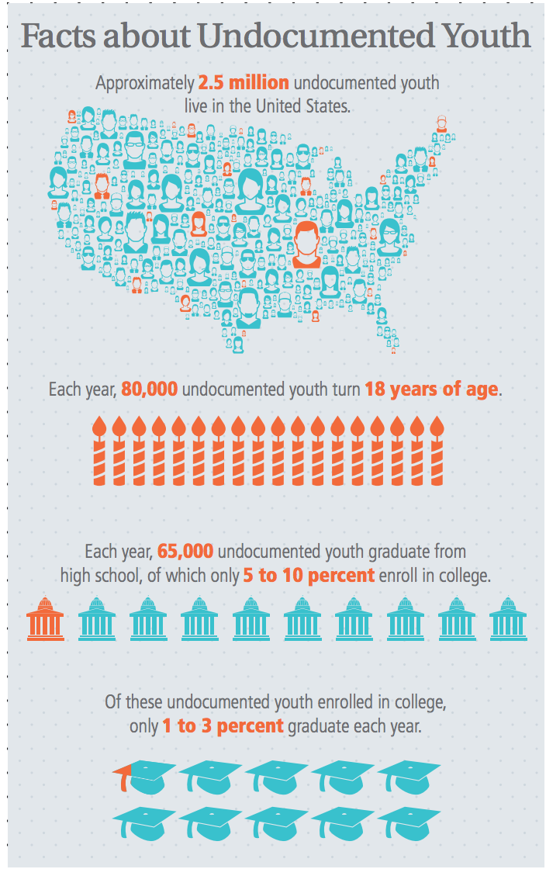
Sharing with a Partner
What kinds of challenges do you think undocumented students may face?
What are you hoping to learn from today’s training?
http://www.aft.org/sites/default/files/im_uac-educators-guide_2017.pdf
Notes:
1.5 minutes to brainstorm- no more than 3 minutes to share out Kim
Goal of this slide: have participants share with one another
Talking points:
Think for a minute about these two questions, and share your thoughts with those around you.

Slide 6
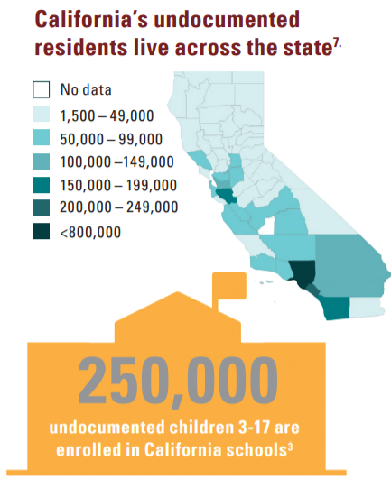
The Undocumented Community in California
California Community Colleges serve the largest number of undocumented students, compared to CSUs and UCs
Exact numbers of undocumented students should not be collected by institutions
At least 13% of California K-12 students have at least one undocumented parent
Notes:
2 minutes
Talking points: Estella
There is currently no true/reliable way to assess how many undocumented students are on campus b/c of FERPA laws.
It doesn’t matter how many students there are - we need to serve them to the best of our ability + as you’ll learn, they are one of the most marginalized groups on campus
Important to meet the needs of u.s. Born students with undocumented parents or siblings (mixed status families)

Slide 7
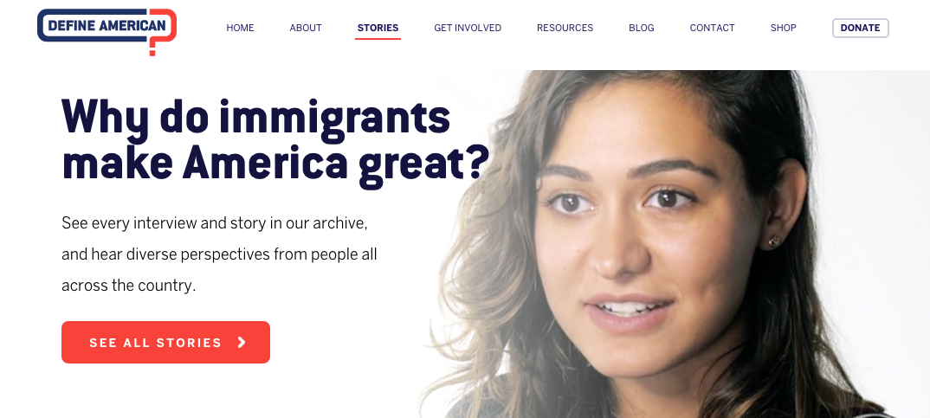
Undocu-Voices
https://defineamerican.com/stories/
Notes:
Kim
10 minutes
Goal: discuss some immigrant stories on this website
Talking points: Ensure our work is informed by the population we are serving- listening to and hearing experiences of undocumented immigrants is crucial.
ask participants to follow the link and read/listen to at least 5 dreamers/undocumented immigrant stories
Discuss origins of define american and author Jose Antonio Vargas he is the founder and CEO and is a leader in shaping immigrant narratives.

Slide 8
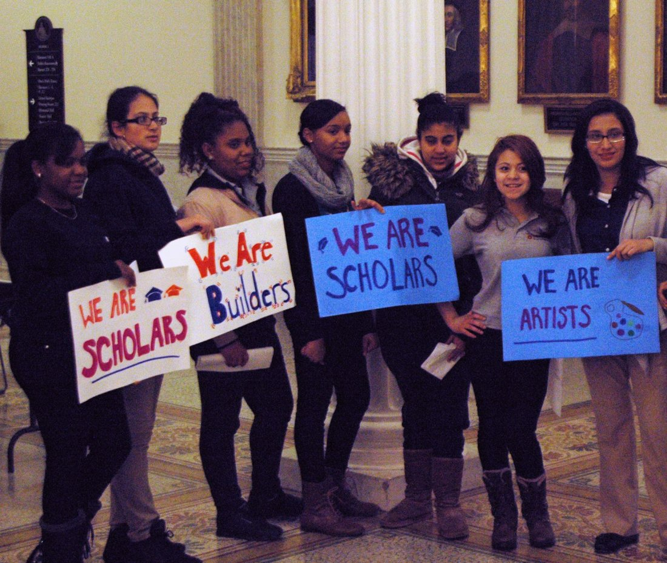
Terminology
Preferred Terms
Undocumented Student Undocumented Immigrant
Dehumanizing Terms
Illegal immigrant Criminal Alien Animals
Terms You May Hear
Many news organizations like the Associated Press, New York Times, LA Times, and NBC News have all established style guides to eradicate these dehumanizing terms, in favor of the preferred terms.
AB 540 student DACAmented Dreamer
Notes:
2-3 minutes Estella
Goal: understanding different terminology
Talking points: explain differences between preferred and dehumanizing terms, and (briefly) touch on terms you may hear.
For further information/support:
California Governor Jerry Brown approved SB 432 in 2015 to remove “alien” from California labor law. (huge, esp when thinking about how immigrants are a driving force in the economy)
https://leginfo.legislature.ca.gov/faces/billTextClient.xhtml?bill_id=201520160SB432-this link is for facilitator
#WordsMatter Video by Define American-optional
https://defineamerican.com/campaigns/wordsmatter/
Library of Congress announced in April 2016 that they would stop using term “illegal alien” bibliographically, now use “noncitizen” or “unauthorized immigrant” instead-for facilitator info only
http://www.latimes.com/nation/la-na-library-congress-alien-20160403-story.html
Think about who uses what terms and in what platforms

Slide 9
Focus on Deconstructing Dehumanizing Stereotypes
“Undocumented people are criminals” | Despite common anti-immigrant rhetoric, several studies show that immigrants are actually less likely to commit crimes than U.S. born citizens. Source
“They don’t pay taxes and receive all benefits” | Those who are undocumented in the U.S. CAN and often DO pay taxes. However, they DO NOT receive any federal benefits such as Social Security, Food Stamps, etc.
“They’re only here to take jobs” | There are MANY reasons why people migrate to the U.S. including: desire to receive a U.S. education, fleeing violent environments, etc.
“All undocumented people are Latinx/Chicanx” | Those who are undocumented in the U.S. migrate from all over the world including: South Korea, India, Canada, and more.
Notes:
3 minutes or less Estella
Goal: discuss importance of deconstructing stereotypes
Talking points: Read “stereotype” and then debunk in your own words (rather than reading from the slide)
Undocumented folks sometimes sacrifice a lot to come to this country, a country that is not welcoming or supportive of them.
Action: Give participants a minute to read, then go over a few of these

Slide 10
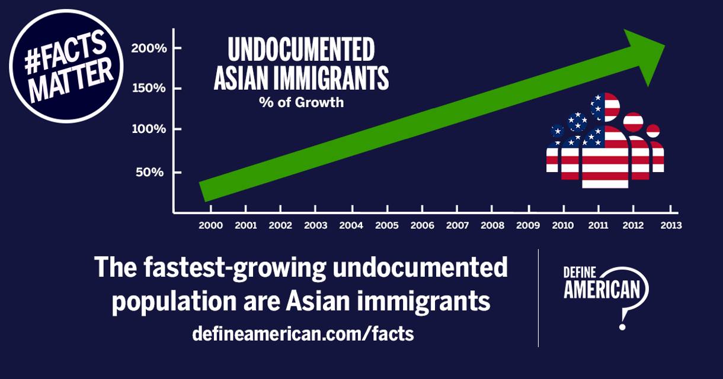
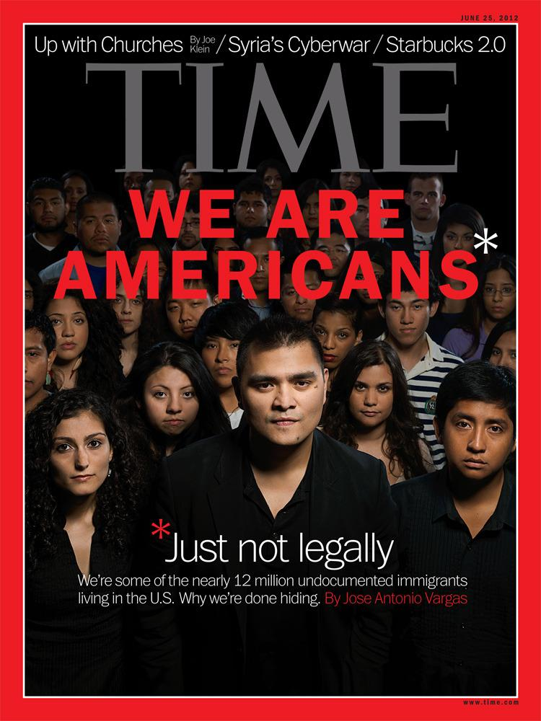
A Range of Experiences
The undocumented student experience varies widely, especially when considering the various intersecting identities someone might exist in.
Depending on the types of protections and benefits students are eligible for, they will face different challenges
http://joseantoniovargas.com/
Notes:
Less than 1 minute Kim
Goal: understand the range of experiences undocumented people have
Talking point:
The undocumented student experience varies widely based on one’s race, ethnicity, immigration pathway, financial situation, whether they are mixed documentation status families, etc.
It’s inaccurate to simplify or generalize the experiences of undocumented students. Even the experiences of students on the Central Coast will not generally reflect the larger experiences.
Undocumented students are not all mexican!

Slide 11
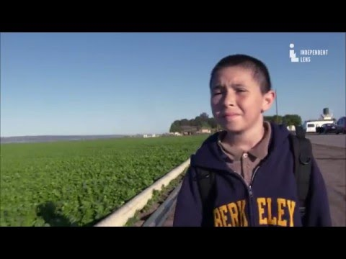
Current Status of Undocumented K-12 Students
http://latinbayarea.com/wordpress/2016/01/03/video-east-of-salinas/
Notes:
10 minutes Kim
Talking point: share one example of how immigration status impacts a student in Salinas, as well as how his teacher supports his immigrant students
Action item: share https://www.youtube.com/watch?v=RsSRnhe_nGw
After watching, share responses

Slide 12
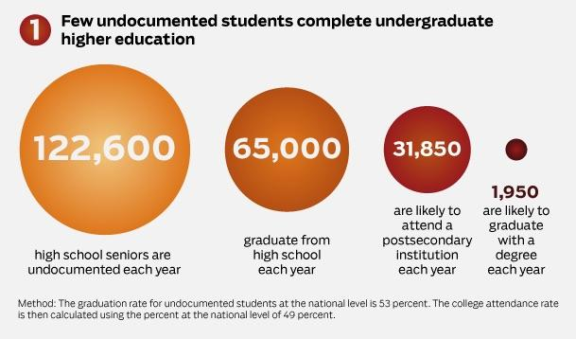
Current Status of Undocumented Students in Higher Ed
Oh, America! You are the land of dreams, but why are you not including me?
Your fertile ground is where seeds are sown, but my crops of dreams have never really grown.
―Emmanuel Mendoza
http://www.thingsillneversay.org/a-conversation-with-america.html
  https://www.americanprogress.org/issues/higher-education/news/2015/03/31/109763/infographic-inside-the-labyrinth-undocumented-students-in-higher-education/
Notes:
1-2 minutes Estella
Goal: overview of the chart
Talking points: Please do not just read the numbers- instead, explain what this means.
HS graduation rate for all students = 80% vs. 53% for undocumented.
If we think of all undocumented HS seniors as potential degree recipients, based on this data, only 1.6% of undocumented immigrants are achieving that potential.
Consider: why is that? What can we do?
You look at this slide and you see numbers. But reflecting on it, these are not just numbers, they are real people, individuals, facing challenges, etc.

Slide 13
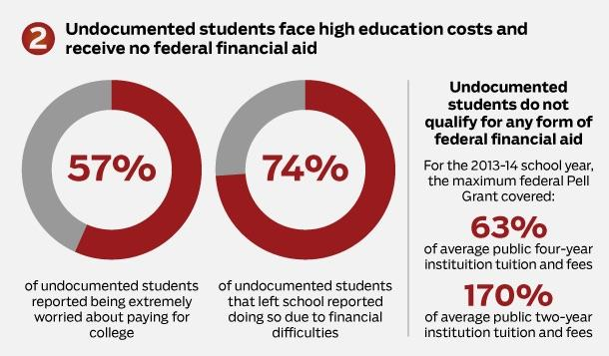
Current Status of Undocumented Students in Higher Ed (cont)
  https://www.americanprogress.org/issues/higher-education/news/2015/03/31/109763/infographic-inside-the-labyrinth-undocumented-students-in-higher-education/
Notes:
1-2 Minutes Estella
Goal: understanding financial fears of undocumented students
Talking Points:
These graphs exemplify the anxiety that undocumented students experience in regards to affording college, and as you can see in the 2nd circle, many, or 74%, leave their university because they cannot afford tuition. This is from a national survey.
At Cuesta: LLN scholarship, Cuesta Promise

Slide 14
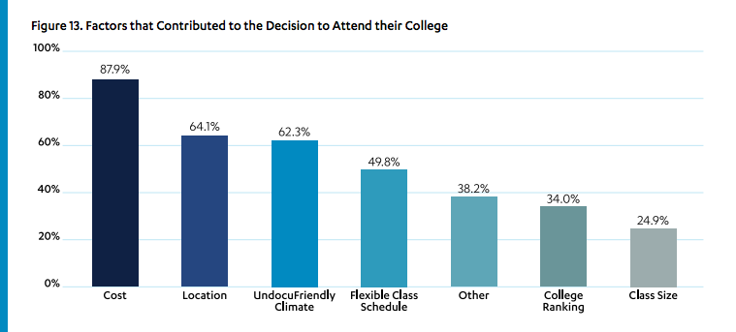
Factors that Influence Decision for College-bound Undocumented Students
The UndocuScholars Project, The Institute for Immigration, Globalization, & Education, UCLA, In the Shadows of the Ivory Tower: Undocumented Undergraduates and the Liminal State of Immigration Reform, 2014
Notes:
1-2 Minutes Kim
Goal: understand factors to choosing school
Talking Points: don’t just read the chart, find 1 or 2 things to highlight
As mentioned on the previous side, cost is a large factor in decision making for undocumented students. The Undocufriendly climate is also a large factor. Through these trainings and other forms of outreach and institutionalization, we’re hoping that prospective undocumented students will see the strides that Cuesta has made to make campus more undocufriendly.

Slide 15
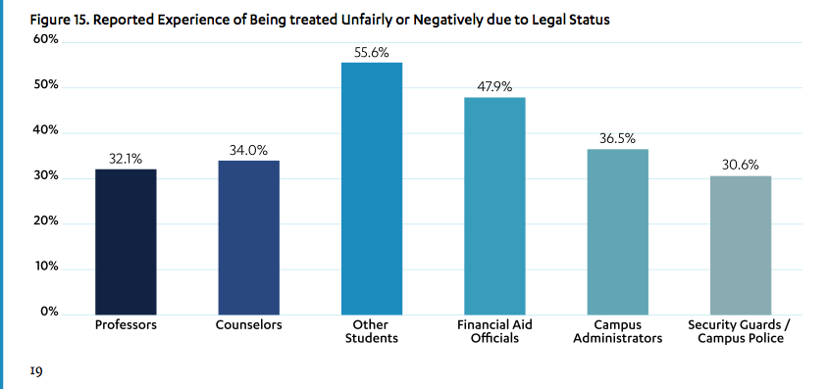
Challenges Faced by Undocumented College Students
The UndocuScholars Project, The Institute for Immigration, Globalization, & Education, UCLA, In the Shadows of the Ivory Tower: Undocumented Undergraduates and the Liminal State of Immigration Reform, 2014
Notes:
1-2 Minutes Kim
Goal: understand interpersonal challenges undocumented students face
Talking Point:
Other students and financial aid officials are the most common groups on campus that undocumented students report being treated negatively by. (Note: security & police is the lowest based on this data.) (national data)

Slide 16

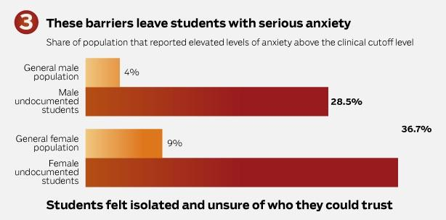
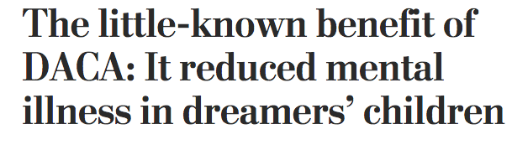
Current Status of Undocumented Students in Higher Ed (cont).
weareheretostay.org/resources/mental-health-emergency-toolkit/
  https://www.americanprogress.org/issues/higher-education/news/2015/03/31/109763/infographic-inside-the-labyrinth-undocumented-students-in-higher-education/
https://www.washingtonpost.com/news/monkey-cage/wp/2017/09/06/the-little-known-benefit-of-daca-it-reduced-mental-illness-in-dreamers-children/?utm_term=.964d35a25005
Notes:
1-2 Minutes Kim
Goal: understand heightened anxiety in undocumented students
Talking Point:
You can see here that many undocumented students experience heightened anxiety and fear which greatly impacts their mental health. Organizations like United We Dream and Here to Stay are dedicated to supporting undocumented immigrants in their education but also in their mental and emotional health. DACA has alleviated some undocumented immigrant
All students have access to counseling at cuesta

Slide 17
Legal Basics: AB 540 (2001)
CA Assembly Bill 540 (2001)
Allows eligible undocumented CA high school graduates to pay in-state tuition regardless of immigration status.
AB 540 Affidavit
Notes:
3 minutes Estella
Goal: Explain AB 540
Action Item: hand out table with differences between laws/executive orders
Talking Points: Undocumented students are considered in the out of state application pool, if they are accepted, they fill out the AB 540 affidavit to receive in-state tuition.
Not all undocumented students are eligible AB 540
Not all AB 540 students are undocumented (as some students who are U.S. citizens who move out of state during HS are also eligible for the tuition waiver)
TIP: Don’t go into detail on AB 540 eligibility → you do not have time & most participants do not need to know this

Slide 18
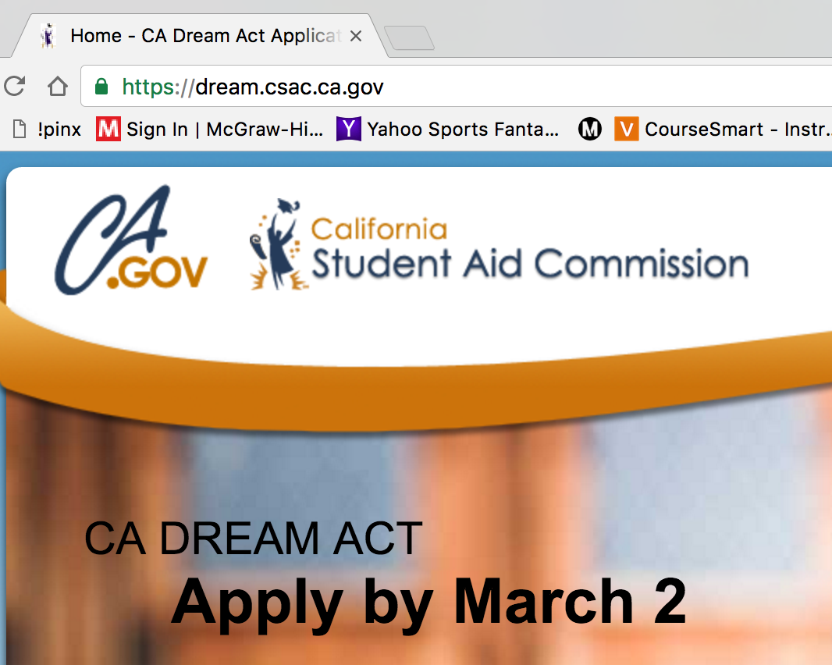
Legal Basics: The CA Dream Act
(2012 & 2013)
CA Assembly Bill 130 & 131 (Dream Act, 2012 & 2013)
Allows eligible AB 540 students access to some types of CA financial aid and scholarships.
Notes:
3 minutes Estella
Goal: define AB 130 & 131 (CA DREAM Act)
Talking points: provides alternative to FAFSA, makes tuition more affordable for undocumented students. Only for AB 540 eligible students.
Undocumented students without AB540 may be eligible for private, non-state, non-federal scholarships
For example, LLN at Cuesta now offering two $250 scholarships for undocumented students, other departments and organizations can offer similar opportunities as long as they are not federal funds.

Slide 19
Legal Basics: DACA (2012)
DACA (Deferred Action for Childhood Arrivals)
Federal executive order that allows some undocumented youth who are “in school” or who have a high school diploma/equivalent to receive a temporary deferral from deportation and be eligible to work.
Notes:
Casey
2 minutes Estella
Goal: Explain DACA
Talking points:
Although DACA eligibility and application is complicated and expensive ($495), there are multiple benefits of receiving DACA. Also must renew every 2 years.
DACA allows students to work safely without fear of deportation but DACA is still not a solution to finding pathways to citizenship and is not sustainable, also some DACA recipients have been deported.
Caution against seeking advice from NOTARIOS or other non-lawyers (including yourself!).

Slide 20
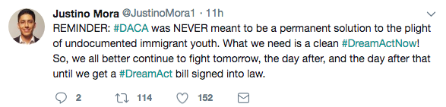
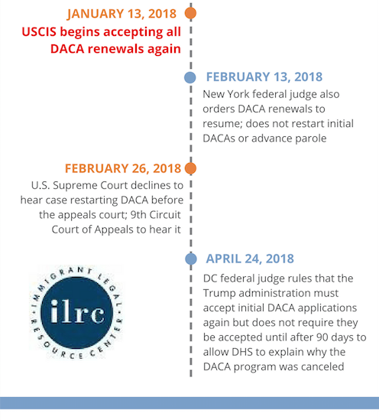
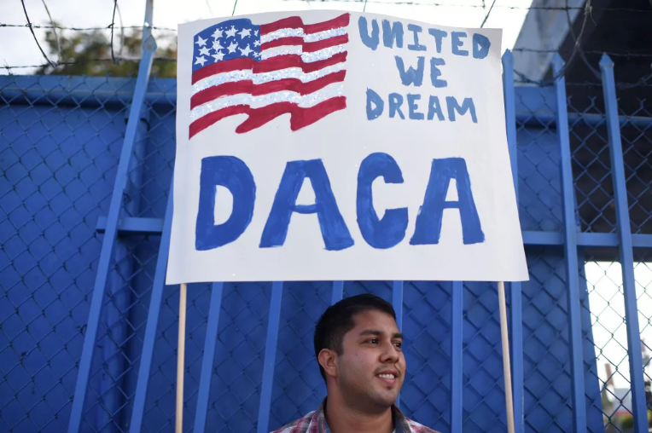
Current Political Context
DACA Timeline
“We can’t keep relying on lawsuits and different presidents to come in and upend our lives,” said Bruna Bouhid, a spokeswoman for United We Dream
DACA Injunction Washington Post
Notes:
2 minutes Kim
Goal: showcase drastic, constant, and inconsistent changes in DACA / federal immigration reform
Talking points:

Slide 21
Review: Legal Basics
CA Assembly Bill 540 (2001)
Allows eligible undocumented CA high school graduates to pay in-state tuition regardless of immigration status.
CA Assembly Bill 130 & 131 (Dream Act, 2012 & 2013)
Allows eligible AB 540 students access to some types of CA financial aid and scholarships.
DACA (Deferred Action for Childhood Arrivals)
Federal executive order that allows some undocumented youth who are “in school” or who have a high school diploma/equivalent to receive a temporary deferral from deportation and be eligible to work.
Notes:
1 minute Estella
Goal: re-emphasize difference between the ABs (they are laws) vs. the federal executive order (not law, not sustainable)
Talking point: Highlight difference between the ABs (they are laws) vs. the federal executive order (not law, not sustainable, at the discretion of the president to continue or discontinue)

Slide 22
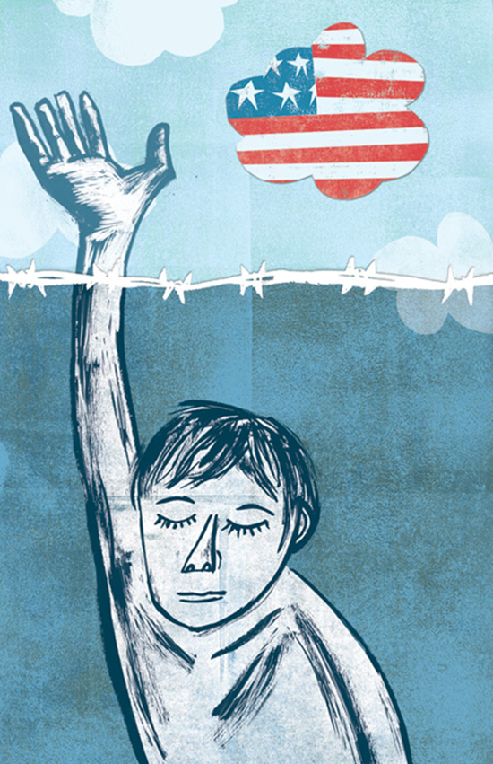
Immediate Steps
Advocate for the rights of undocumented students to be on campus, to be treated with respect, and to earn a degree
Respect students’ privacy / do not “out” students or ask students to self-identify
“I cannot offer legal advice, but here is a resource that can help.”
“Top 10 Ways to Support Undocumented Students” Educators for Fair Consideration, www.e4fc.org
Notes:
2 minutes Estella
Goal: focus on immediate steps for participants
Action: share resource guide
Talking points:
Read first two, elaborate if necessary.
If a student comes to you for help, it’s okay to say ‘I don’t know the answer, but these folks might,’ or ‘here are some resources’
if they come to you for legal advice, definitely say “I cannot offer legal advice, but here are resources that can help”, as false information can jeopardize students’ safety.
Honestly answer questions about students’ futures / sometimes this will be hard!

Slide 23
Contact Information
To learn more about the Central Coast Coalition for Undocumented Student Success or to join this work, please visit our website ccc-uss.org or contact ccc.undocu@gmail.com
Estella Vazquez, Cuesta College LLN President 2017-2018
  evazquez@cuesta.edu, (805)546-3100 ex. 2182
Kim Espino, Assistant to the Latina Leadership Network chapter at Cuesta College
  kimberly_espino@cuesta.edu

