Slide 1
DSPS
Disabled Student Programs and Services

Slide 2
Hours Available
On campus by appointment only 805-546-3148:
M: 8-4:30pm
T: 8-6pm
W: 8-6pm
TH: 8-4:30pm
F: 8-4:30pm
Zoom availability:
Mon-Thurs 10-2pm
https://cuesta-edu.zoom.us/j/99910623850

Slide 3
Faculty Notification Letters
Each semester faculty should receive a letter from students in DSPS notifying them of their student’s accommodations.
It is the students’ responsibility to send their Faculty Notification Letter each semester. This notification letter outlines which accommodations the student is approved for, and plans on using for the class.
Some students may be in DSPS, but choose not to use their accommodations. In this case, you may not receive a notification letter.

Slide 4
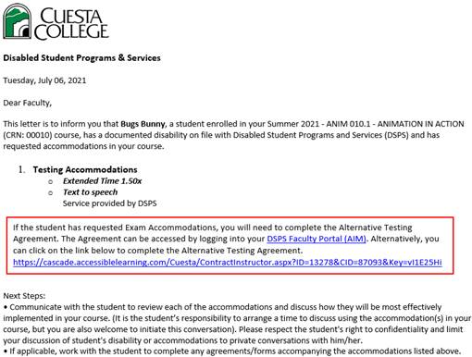

Slide 5
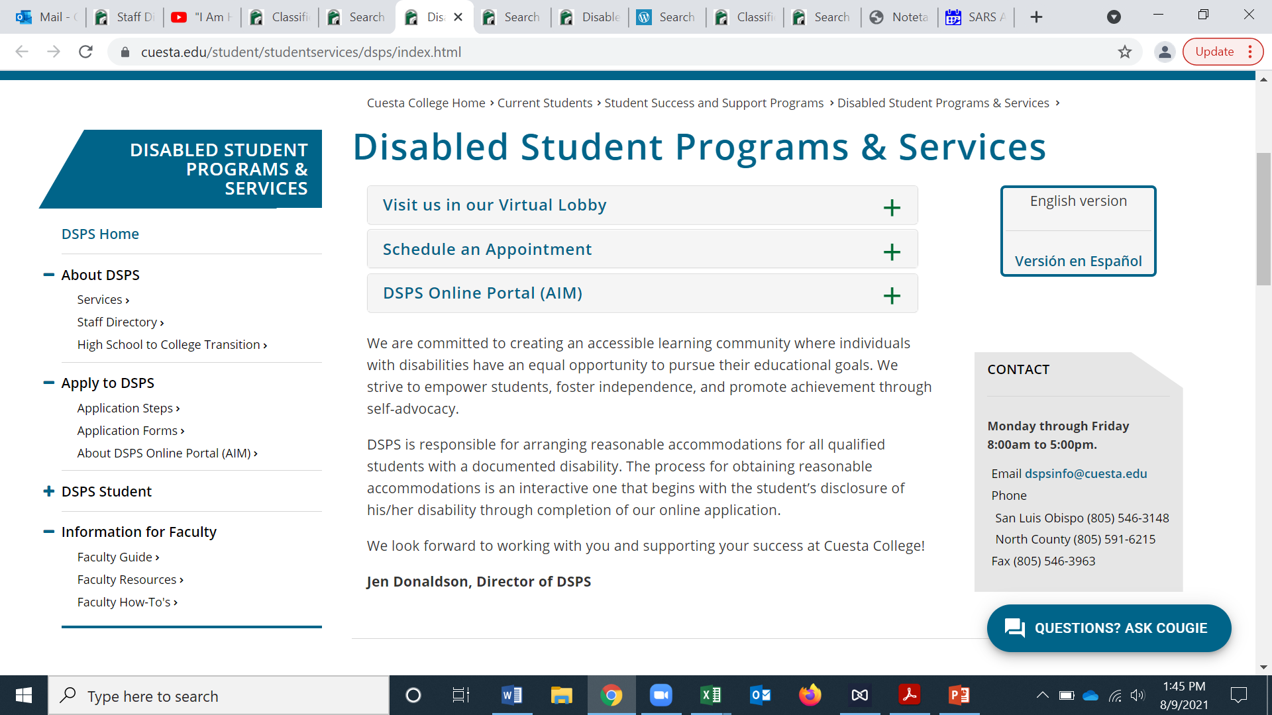
Website
Check out our updated Faculty Information section on our website for more information. https://www.cuesta.edu/student/studentservices/dsps/dsps_faculty/index.html

Slide 6
DSPS Staff
Please reach out with any questions or concerns.
Jennifer Donaldson Director jennifer_donaldson@cuesta.edu
Michelle Bach Peters Department Assistant michelle_bachpeters@cuesta.edu
Judy Rittmiller Program Assistant NCC jrittmil@cuesta.edu
Loren Buckingham Testing Coordinator lbucking@cuesta.edu
Christine Groff Accommodation Assistant christine_groff@cuesta.edu
Alexis Delevette Alt Media Facilitator alexis_delevett@cuesta.edu
Jo Malizia ASL Interpreter joann_malizia@cuesta.edu
Jamie Bettencourt Academic Success Coach Jeremy_bettencourt@cuesta.edu
Lisa Curtis Specialist lcurtis@cuesta.edu
Kathy Peters Specialist kpeters@cuesta.edu
Veronica West Counselor veronica_valiantwest@cuesta.edu

