Slide 1
Supporting Men of Color in Community Colleges: Trends, Challenges, and Opportunities

Slide 2
Overview
Highlight national trends and issues that impact student success outcomes for men of color in community colleges
Discuss the convergence of gender and racial identities and how it shapes educational experiences and outcomes for men of color
Present high-impact institutional practices to redress outcome disparities for men of color in community colleges

Slide 3
Our Lab
The Community College Equity Assessment Laboratory (CCEAL) is a national research and practice lab that partners with community colleges to support their capacity in advancing outcomes for students who have been historically underserved in education, particularly students of color.
CCEAL houses the Minority Male Community College Collaborative (M2C3).
CCEAL was developed to advance three objectives:
Research - to conduct and disseminate empirical research on the experiences of historically underserved students in community colleges;
Training - to provide training that improves practices and research relevant to students of color in community colleges; and
Assessment - to use assessment and evaluation to facilitate capacity-building within community colleges.

Slide 4
Mixed Methods, Case Study Research
Quantitative Research and Assessment
Community College Success Measure (CCSM)
for identifying factors influencing the success of underserved students
CC Instructional Development Inventory (CCIDI)
to inform professional development programming for instructional faculty
Community College Student Success Inventory (CCSSI)
for determining an institution's readiness to support underserved students
Male Program Assessment for College Excellence (MPACE)
for examining the efficacy of programs serving college men of color
102 colleges
9 states, 78,614 students
120 colleges
40 states, 2,789 instructional faculty
IAP
40 colleges
15 states
45 colleges
24 states

Slide 5
Mixed Methods, Case Study Research
Qualitative Research and Sensemaking
Student focus groups
Examining students’ perceptions of factors influencing success in community college
Faculty interviews
Examining perceptions of factors that are effective in educating students of color in community colleges
Consensus focus groups
Collective sensemaking approach for identifying root challenges facing students in community colleges from an equity-based perspective
Narratives of success
Narratives from educators with a documented record of success in teaching and supporting underserved students of color
10 colleges
CA, 252 students, 50 focus groups
10 colleges
CA, 102 faculty
32 colleges
CA & MN, 240 faculty/staff
48 consensus groups
14 colleges
12 states, 78 educators

Slide 6
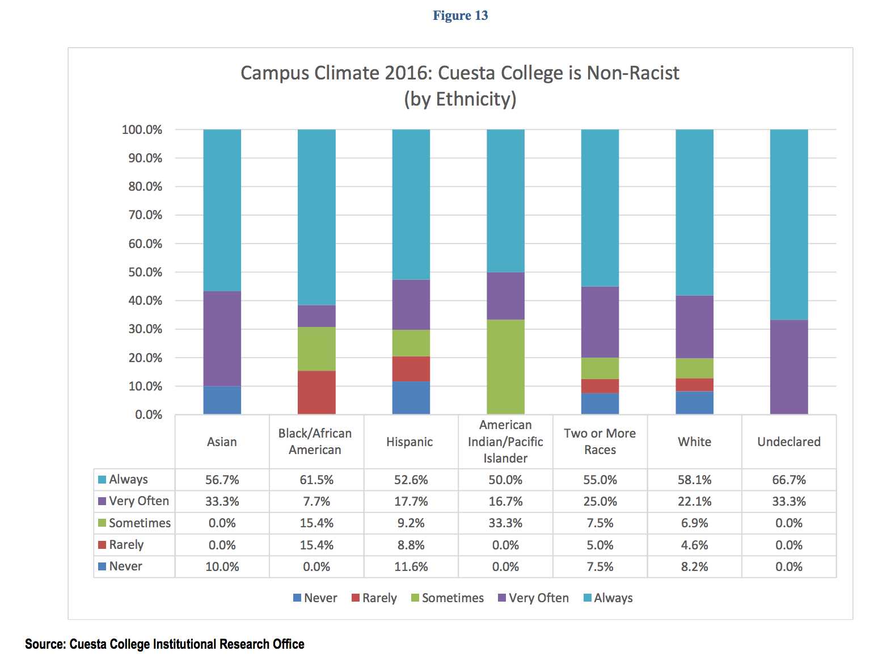
CCSSE Climate Survey Results

Slide 7
CCSSE Climate Survey Results

Slide 8
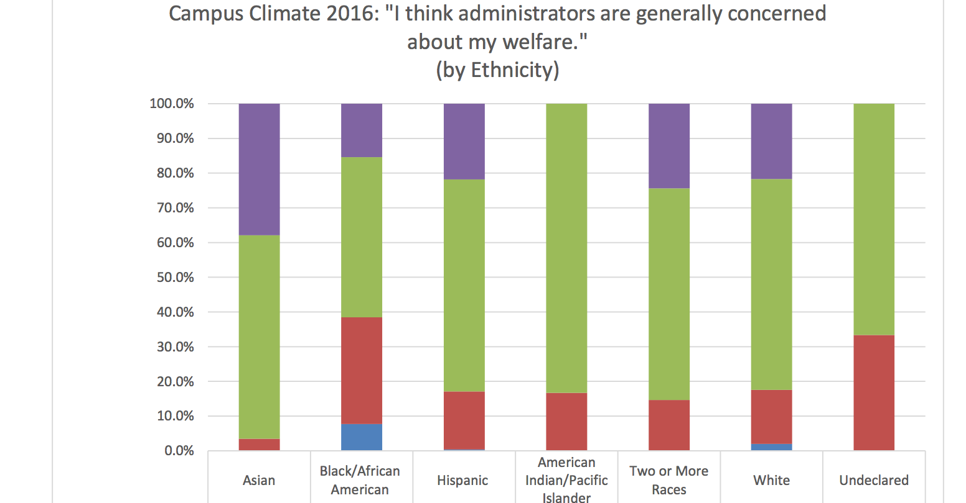
CCSSE Climate Survey Results

Slide 9
CCSSE Climate Survey Results

Slide 10
Socio-Ecological Outcomes (SEO) Model
Inputs
Socio-Ecological Domains
Outcomes
Non-Cognitive Domain
Academic Domain
Background/ Defining Factors
Environmental Domain
Student Success
Societal Factors
Campus Ethos Domain
Structural Domain

Slide 11
Socio-Ecological Outcomes (SEO) Model
Inputs
Socio-Ecological Domains
Outcomes
Non-Cognitive Domain
Intrapersonal (Self-Efficacy) (Locus of Control) (Degree Utility) (Action Control) (Intrinsic Interest)
Identity (Gender) x (Racial/Ethnic) x (Spiritual) x (Sexual)
Background/ Defining Factors
Age
Time Status
Veteran Status
Primary Language
Citizenship Status
[Dis]ability
Academic Domain
Faculty-Student Interaction
Academic Service Use
Commitment to Course of Study
Environmental Domain
Mediators (Finances) (Transportation)
Commitments (Dependents) (Employment)
Stressful Life Events
Student Success
* Persistence * Achievement
* Attainment * Transfer * Goal Accomplishment *Labor Market
Societal Factors
Stereotypes
Criminalization
Economic Conditions
Mass Incarceration
Capital Identity Projection
Campus Ethos Domain
Sense of Belonging (Student-Student) (Student-Faculty) (Student-Student Service)
Campus Racial/Gender Climate
Welcomeness to Engage
Internal Validating Agents (Faculty) (Staff)
Personal Relationships
Structural Domain
Training infrastructure
Built environment
Staffing patterns
Equity resourcing

Slide 12
Societal Factors
Societal Factors
Stereotypes
Prejudice
Criminalization
Economic Conditions
Capital Identity Projection
Mass Incarceration

Slide 13
Societal Factors (Stereotypes)
“I can’t tell you how many times I’d be sitting at one of the study cubicles and security would come to me and ask for my student ID. At first I thought it was something that they did to everybody when it got late but then I started to notice they asked me for mine and didn’t ask anyone else for theirs.”
(Harris III & Wood, 2016)
"I needed the most help on my writing, and the teacher was looking at me like, ‘ahhhhh [exhale], here we go. You know, we got a r******d kid in class now.’”
(Wood, 2015)

Slide 14
Societal Factors (Stereotypes)
“Yeah, so I feel that [stigma] has some effect on the way the professors interact with you, I noticed a little shortness with a few of the professors that I have dealt with. I guess their assumption is you probably won’t be here after financial aid gets distributed, so they’re a little hands off. So they don’t really take you seriously until the third week of school or you show up in their office.”

Slide 15
Non-Cognitive Domain
Non-Cognitive Domain
Intrapersonal (Self-Efficacy) (Locus of Control) (Degree Utility) (Action Control) (Intrinsic Interest)
Identity (Gender) x (Racial/Ethnic) x (Spiritual) x (Sexual)

Slide 16
Non-Cognitive Domain (Intrapersonal)
“I worry that being here is not worth it because I see a lot of people that graduated from college with all sorts of degrees and still can’t get a job and are still struggling. So I’m like ‘damn, I’m spending all this money on student loans, what’s going to happen if I don’t get a job?”

Slide 17
Non-Cognitive Domain
Non-Cognitive Domain
Intrapersonal (Self-Efficacy) (Locus of Control) (Degree Utility) (Action Control) (Intrinsic Interest)
Identity (Gender) x (Racial/Ethnic) x (Spiritual) x (Sexual)

Slide 18
Non-Cognitive Domain (Identity)
“What kind of man has two kids and quits working so he can go and read poetry at some damn college?”
(Harris & Harper, 2008)

Slide 19
Non-Cognitive Domain (Identity)
“It also comes from a sense of pride. You know, you’re always taught to be a man, and you’re proud. And, if you fall, if you stumble, then that’s your own fault. You don’t bring anybody down with you. You don’t ask for help because it’s your doing. You shouldn’t have to ask anybody for help, and so it’s just that sense of pride that carriers over – that in the end, makes you fail.”
(Saenz et al., 2013)
“When I want help, I usually don’t ask for help… I'm more like I'll find it myself. And sometimes finding it yourself doesn't help you that much. You're in the same spot you were. So, I mean, I can, I find myself taking longer to figure out things than a kid that would ask questions. And that's one of the things that affects me.”
(Wood, 2010)
“What kind of man has two kids and quits working so he can go and read poetry at some damn college?”
(Harris & Harper, 2008)

Slide 20
Academic Domain
Academic Domain
Faculty-Student Interaction
Academic Service Use
Commitment to Course of Study
“I have to take 3 buses to get to school. Transportation is a real concern. If I miss one bus, or one bus runs late, it means that I don’t make it to class on time. Yeah, I spend like an hour, sometimes an hour and a half just getting to school.”

Slide 21
Academic Domain
“. . . . the professor made us take ownership of the knowledge that was given out, and it wasn't two hours of just [lecturing], it was like ‘okay now that you wrote this explain this to me, what does this mean to you?’ ”
“[The professor would ask] ‘I know that you see the definition that is on the board, how would you give this information out to somebody that is on the street? What [does] this actually mean in reality?’ Especially with political science. It is like you have this huge bubble of political matters and congress and senate and all of the things that fall into those umbrellas it is easy to have this influx of information just hitting you.”

Slide 22
Environmental Domain
Environmental Domain
Mediators (Finances) (Transportation) (External Validating Agents)
Commitments (Family Responsibilities) (Employment)
Stressful Life Events
“I have to take 3 buses to get to school. Transportation is a real concern. If I miss one bus, or one bus runs late, it means that I don’t make it to class on time. Yeah, I spend like an hour, sometimes an hour and a half just getting to school.”

Slide 23
Environmental Domain
“I’ve had more than a few family members die in the past two years, so it’s just hard to focus. I kinda lost my motivation and I really can’t focus. My family needs me now more than ever before. When I’m in class I’m physically there but my mind isn’t.”

Slide 24
Environmental Domain
“I have to take 3 buses to get to school. Transportation is a real concern. If I miss one bus, or one bus runs late, it means that I don’t make it to class on time. Yeah, I spend like an hour, sometimes an hour and a half just getting to school.”

Slide 25
Environmental Domain
Percentage of students by race and gender with housing insecurities, CCSM 2016

Slide 26
Environmental Domain
Percentage of students by race and gender with food insecurities, CCSM 2016

Slide 27
Campus Ethos Domain
Campus Ethos Domain
Sense of Belonging (Student-Student) (Student-Faculty) (Student-Student Service)
Campus Racial/Gender Climate
Welcomeness to Engage
Campus Resources (Access) (Efficacy)
Internal Validating Agents (Faculty) (Staff)

Slide 28
Campus Ethos Domain
“There are some teachers that will tell you,. ‘I’ve probably given just one A in the last 3 years.’ That’s bulls^!t. Because you even get to class you know you can’t get an A.”
“The professor emphasized multiple times that if you’re not getting it, drop the class. No ways on how I could improve. Just drop the class.”

Slide 29
Campus Ethos Domain
“There are some professors that will tell you,. “I’ve probably given just one A in the last 3 years’.” That’s bulls^!t. Because before you even get to class you know you can’t get an A.”
“When faculty members see me, they put their head down, pretend like they don’t see me, walk the other direction, or pretend to get on the phone.”
(Wood & Harris III, 2016)
“Professors who are here for the passion of working with students really make a difference. Professors who really care and take the time to get to know you are the ones I learn the most from.”
“[Professors say] do not take this class, at all. Don’t even try to take this class. The professor emphasized multiple times that if you’re not getting it, drop the class. No ways on how I could improve. Just drop the class.”

Slide 30
Structural Domain
Inputs
Structural Domain
Training infrastructure
Built environment
Staffing patterns
Equity resourcing

Slide 31
Structural Domain
“Colleges have structured educational experiences in a manner that place students in need of the greatest level of support in classes with faculty who often provide the least…too few campuses compensate part-time faculty for holding office hours and provide them with space to meet students.”
(Wood et al., 2017)
“[Many] community colleges are required to have an early alert system… However, a noticeable contingent of these systems simply do not work, are not used by faculty, and notify academic advisors …far too late into the semester (i.e., halfway through), far beyond the point where an intervention could curb challenges.”
(Wood et al., 2017)

Slide 32
Structural Domain

Slide 33
Structure Matters
Legend
Acceptable
Emerging Concern
Needs Attention
Immediate Attention
Part-Time Faculty in Developmental Education
 | Part-Time Faculty Teaching Here Part-Time | Part-Time Faculty Teaching Here Full-Time | Part-Time Faculty Teaching at Multiple Institutions | Part-Time Faculty Overall
Collaborative Learning | Immediate Attention | Acceptable | Immediate Attention | Needs Attention
Culturally Relevant Teaching | Acceptable | Acceptable | Emerging Concern | Acceptable
Performance Monitoring | Acceptable | Needs Attention | Immediate Attention | Emerging Concern
Relationship-Building | Acceptable | Acceptable | Immediate Attention | Acceptable
Institutional Responsibility | Immediate Attention | Immediate Attention | Immediate Attention | Immediate Attention
High Expectations | Immediate Attention | Immediate Attention | Immediate Attention | Immediate Attention
Validating Messages | Acceptable | Acceptable | Needs Attention | Acceptable
Faculty Student Engagement | Acceptable | Acceptable | Immediate Attention | Acceptable
Appropriate Disclosing | Needs Attention | Acceptable | Immediate Attention | Needs Attention
Welcoming Engagement (In Class) | Immediate Attention | Acceptable | Immediate Attention | Emerging Concern
Welcoming Engagement (Out of Class) | Acceptable | Acceptable | Immediate Attention | Acceptable
Empowerment | Acceptable | Acceptable | Needs Attention | Acceptable
Intrusive Practices | Acceptable | Acceptable | Needs Attention | Acceptable
Microaggressions | Immediate Attention | Acceptable | Immediate Attention | Needs Attention
Note: Scores for “Immediate Concern” and “Acceptable” represent statistically significant differences based on national exemplar colleges.

Slide 34
Strategies for Student Equity and Success
Recommendations for Institutional Commitment
Ensure campus leaders communicate urgency about a focus on students experiencing DPI at high profile events, including convocation
Hire personnel with a proven record of success in working with underserved students
Implement a campus-wide early alert system
Integrate equity plan goals into the institution’s strategic plan
Identify advocates for working with underserved students within campus departments
Increase representation of full-time faculty in developmental education
Provide high-impact professional development for all faculty and staff

Slide 35
Strategies for Student Equity and Success
Recommendations for Institutional Commitment
Ensure campus leaders communicate urgency about a focus on students experiencing DPI at high profile events, including convocation
Hire personnel with a proven record of success in working with underserved students
Implement a campus-wide early alert system
Integrate equity plan goals into the institution’s strategic plan
Identify advocates for working with underserved students within campus departments
Increase representation of full-time faculty in developmental education
Provide high-impact professional development for all faculty and staff

Slide 36
Strategies for Student Equity and Success
Recommendations for Academic Divisions
Set targets for improving disproportionate impact (DPI) groups for each department
Set a standing division agenda item focused on the progress of DPI groups
Use resident disciplinary experts to support the infusion of culturally relevant teaching (CRT)
Establish professional learning communities to continue the dialogue on CRT throughout the academic year
Engage in ongoing, collective sense-making at the campus and unit-level

Slide 37
Strategies for Student Equity and Success
Recommendations for Classroom Faculty
Require conferencing with all students throughout the semester
Discuss challenges you’ve experienced and overcame
Structure success early on
Recognize the influence of microaggressions on student success
Require supplemental instruction for classes with high D, F, W rates
Be intentional about warmly welcoming all students to each class session
Initiate communication with students who miss two or more class sessions

Slide 38
Online Certificate Programs
TEACHING MEN OF COLOR IN THE COMMUNITY COLLEGE
SUPPORTING MEN OF COLOR IN THE COMMUNITY COLLEGE
TEACHING BOYS AND YOUNG MEN OF COLOR
Center for Organizational Responsibility and Advancement
PROGRAMS FEATURE
Designed for community college educators
One-week long program
Fully online program delivery
Live interactive dialogue with instructors
Tangible solutions for real challenges
LEARNING FORMAT
e-Learning videos
Virtual discussion board
Real-time conferencing with instructors
Practical readings
TARGET AREAS OF INTERVENTION
Racial Microaggressions
Collaborative Learning
High Expectations
Validation
Personal Relationship
Challenge
Support
Culturally Relevant Teaching
Culturally Relevant Materials
Empowerment Strategies
Intrusivity
Performance Monitoring
LEARN MORE at www.coralearning.org
CONTACT at bherrin@coralearning.org
This is a non-credit, non-CEU professional development training program

Slide 39
Books on College Men of Color
for Instructional Faculty
for Classified Staff
for k-12 educators

