Slide 1
Open Forum 16-week calendar
Friday, October 13, 2023

Slide 2
Welcome
Panel introductions
Overview
Facilitated discussion
Panel closing comments

Slide 3
Taskforce and Panelists
Thank you!
Dr. Greg Baxley
Dr. Wes Sims
Galadriel Bree Highhouse
Dr. Matthew Davis
Brittany Mojo
Dr. Ryan Cartnal
Dr. Jason Curtis
Dr. Maria Escobedo
Dr. Oscar Ramos
Keith Stearns

Slide 4
Overview
Calendar taskforce launched November 2022
Significant campus interest for many years
Several previous attempts by the Calendar Committee
No clear process for a major college redesign
Two Leadership Retreats pre-pandemic
Concerns and questions amassed
Cal Poly confirmed move to 15+1 calendar

Slide 5
Overview
Minimum Requirement for Adoption
Neutral to positive net impact on FTES
Broad support of the campus community

Slide 6
Overview
Essential Elements
Unified class start times
16-week summer to support pre-nursing, STEM, and CE Programs
4 and 8-week class delivery options
Robust summer schedule
Effective early alert and holistic support model (Student Success Teams)

Slide 7
Recommendation
The task force recommends a move to an academic calendar that includes two 16-week semesters, starting no later than 2026-2027.

Slide 8
Rationale
Aligns with Cal Poly calendar beginning 2026/27
More attractive to DE students enrolling through CVC than 18 week courses
DE courses no longer calculated using the college’s TLM, all are at 17.5
Shift to 16-week calendar will result in natural increase in FTES estimated at 3% in fall, and 2% in spring
Shorter term reduces exit points for students

Slide 9
Additional considerations
Term length multiplier of 16.8
Includes 4 Flex days immediately preceding start of both fall and spring terms
No flex days integrated into semester
Capacity of facilities to support extended class times determined sufficient

Slide 10
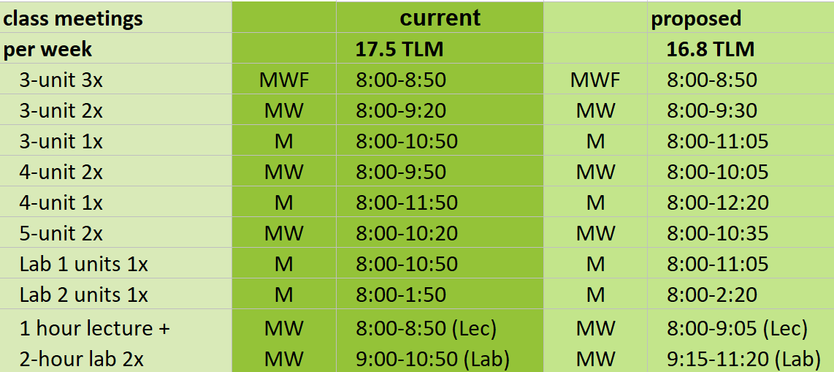
Additional considerations-extended class times

Slide 11
Discussion
To ensure everyone can hear, please raise your hand and we will bring a mic to you.

Slide 12
Panel closing remarks

Slide 13
Next Steps
Gather campus feedback
Adjust/revise/amend as appropriate
Launch governance review
Bring recommendation to the Board of Trustees

Slide 14
Thank you for joining the conversation!

